Slide 1

DIABETES PREDICATION ASSESSMENT QUESTIONS
Using SQL
Mohamed Adel

Slide 2
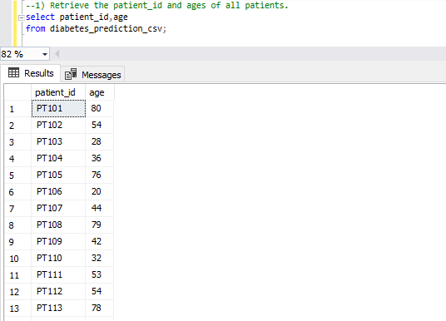
1. Retrieve the Patient_id and ages of all patients.

Slide 3
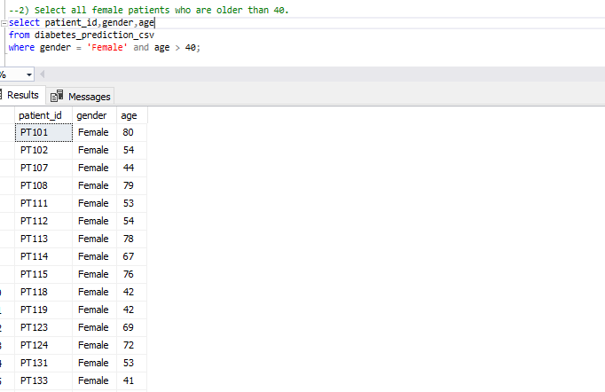
2. Select all female patients who are older than 40.

Slide 4
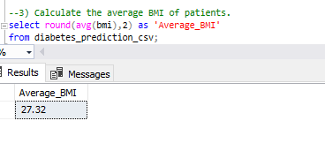
3. Calculate the average BMI of patients.

Slide 5
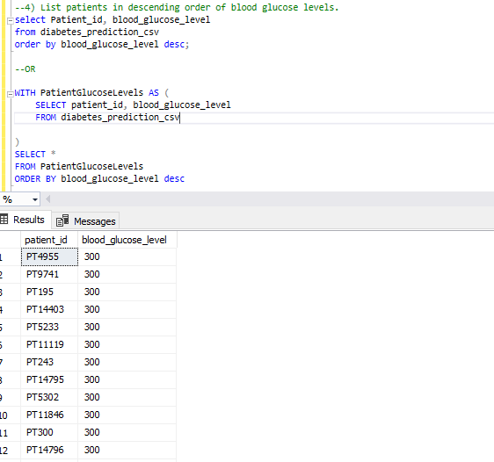
4. List patients in descending order of blood glucose levels.

Slide 6
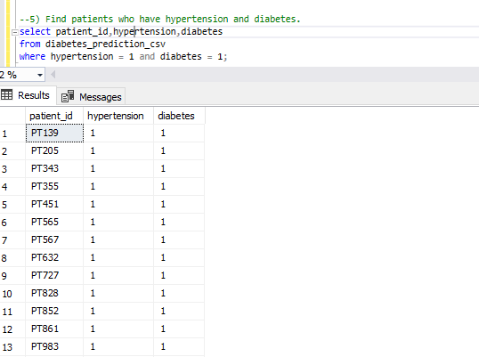
5. Find patients who have hypertension and diabetes.

Slide 7
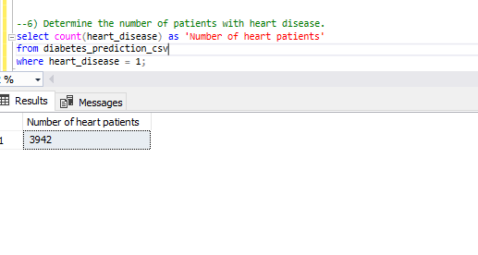
6. Determine the number of patients with heart disease.

Slide 8
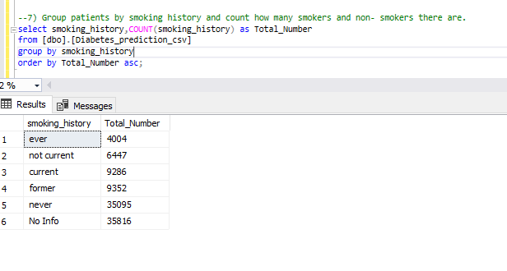
7. Group patients by smoking history and count how many smokers and non- smokers there are.

Slide 9
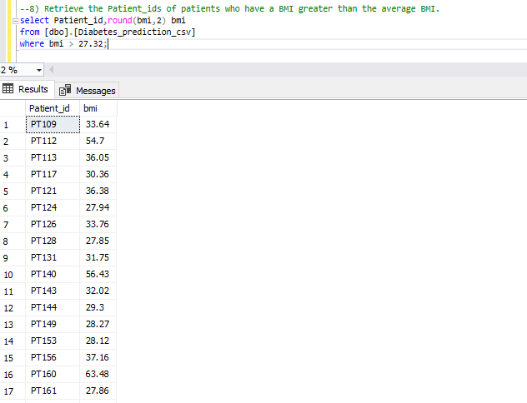
8. Retrieve the Patient_ids of patients who have a BMI greater than the average BMI.

Slide 10
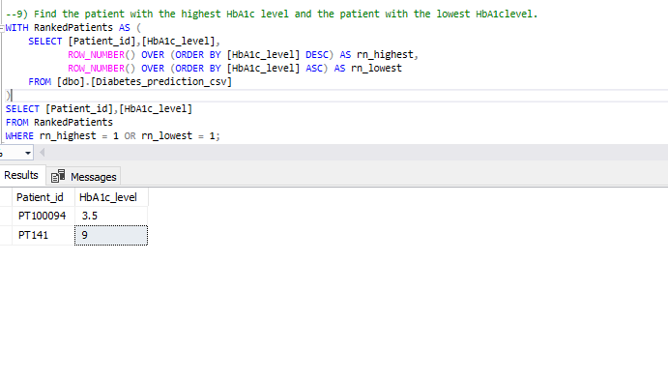
9. Find the patient with the highest HbA1c level and the patient with the lowest HbA1clevel.

Slide 11
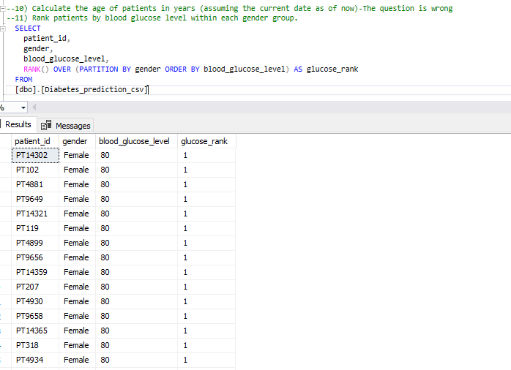
11. Rank patients by blood glucose level within each gender group.

Slide 12
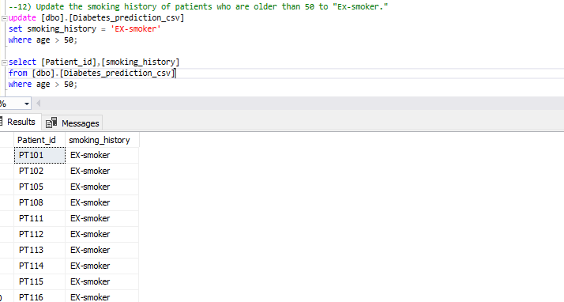
12. Update the smoking history of patients who are older than 50 to "Ex-smoker."

Slide 13
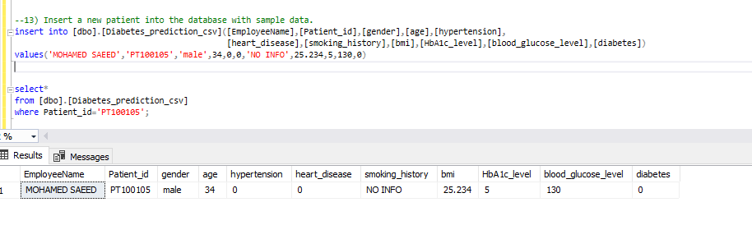
13. Insert a new patient into the database with sample data.

Slide 14
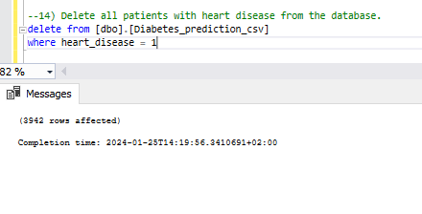
14. Delete all patients with heart disease from the database.

Slide 15
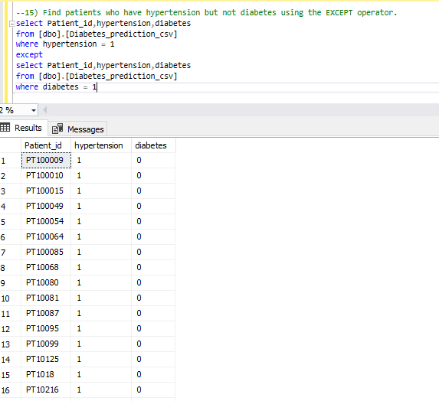
15. Find patients who have hypertension but not diabetes using the EXCEPT operator.

Slide 16
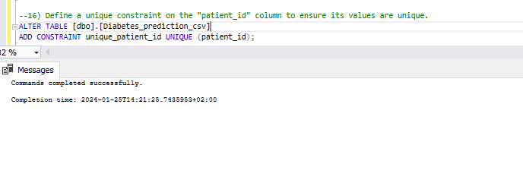
16. Define a unique constraint on the "patient_id" column to ensure its values are unique.

Slide 17
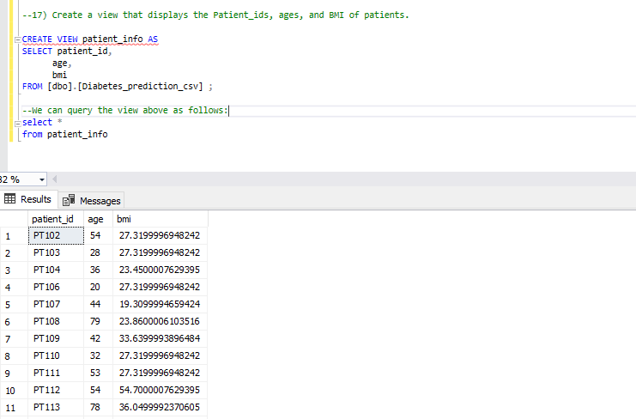
17. Create a view that displays the Patient_ids, ages, and BMI of patients.

Slide 18
18. Suggest improvements in the database schema to reduce data redundancy and improve data integrity.
To reduce data redundancy and improve data integrity in the database schema, here are some suggestions:
1)Normalize the Data: Split the data into separate tables to eliminate duplicate data and reduce the risk of inconsistencies.
For example, you can create separate tables for patient details, conditions, and measurements.
2)Use Foreign Keys: Establish relationships between tables using foreign keys to enforce referential integrity. For example, you can link patient conditions to the patient table using patient IDs.

Slide 19
19. Explain how you can optimize the performance of SQL queries on this dataset.
I was used window functions and common table expressions (CTEs) can help improve the performance of SQL queries on the dataset in certain cases. Window functions can be used to perform complex calculations and aggregations without the need for subqueries or temporary tables which can lead to more efficient query execution. CTEs can help to simplify and organize complex queries, making them easier to understand and maintain.

Slide 20
THANK YOU
Mohamed Adel Kasim
+201064247953
moonororsun@gmail.com

